Slide 1



ADOLESCENCE HEALTH-
Significance and Factors Influencing Adolescence Health
HEALTH AND LIFESTYLE CLASS - 9

Slide 2

Adolescences-YA10-13yrs; MA14-16yrs;OA17-19yrs
Adolescence is a time of immense biologic, psychological, and social change. Stage of Development- Transitions from childhood to adulthood. These rapid changes in hormonal milieu, changing ideas and concepts about the world, having to cope up with the expectations from the society and need to establish their own identity keep them in lots of pressure.

Slide 3

Adolescents in India?
India is the home of 243 million adolescence- Children aged 10-19 yrs
It accounts for about 21.3% of population of the country
Currently married are 30% & Birth by age 18 yrs-21.7%
Boys currently married (age group 15-19yrs) are 4.6%

Slide 4

Burden of Health
An estimated 1.3 million adolescent died in 2015, mostly from preventable or treatable causes.
Road traffic injuries were the leading cause of death in 2015, with approximately 330 adolescent dying every day.
Other main causes of adolescent deaths include HIV, suicide, lower respiratory infections and interpersonal violence.
Half of all mental heath disorders in adulthood appear to start by age,14, but most cases are undetected an untreated.

Slide 5

Why adolescents are Vulnerable to focus?
Adolescence is a critical link between childhood and adulthood, characterized by significant physical, psychological, and social transitions.
Characterized by physical, emotional, and social changes, which can bring about irratic emotions resulting in stress and conflict.
Adolescence is also viewed as a stage in one's life when there are plenty of opportunities for personal growth

Slide 6
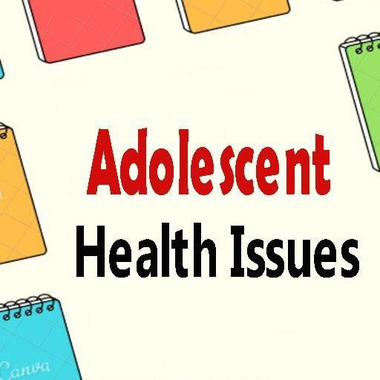
Nutrition
Mental Health
Early Pregnancy
Gender Dysphoria
Sexually transmitter disease
Sleep disturbances
Obesity
Gynecological problems
Substance Abuse
Violence
Sex Education
Social Challenge

Slide 7
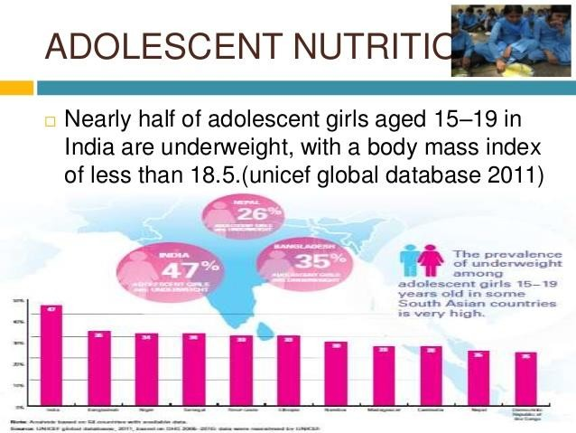

Slide 8
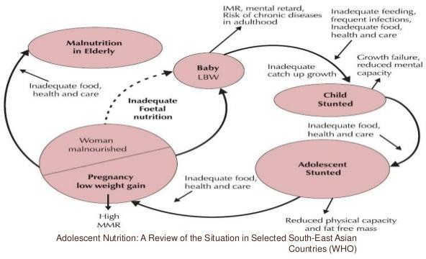
Nutrition throughout lifecycle

Slide 9
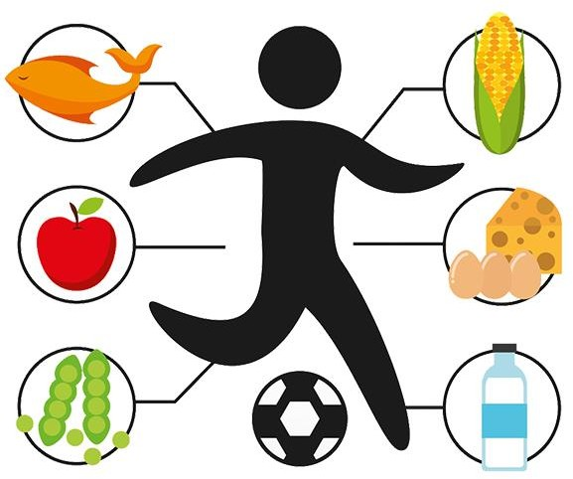
Adolescent Nutrition
There is increase in nutritional requirement during this period of rapid growth micronutrient being as important as energy and protein.
Lack of sun exposure with modest tradition of clothing coupled with dark skin pigment causes vitamin D deficiency.
Insufficient diary product intake in under privileged girls leads to poor intake of protein and calcium resulting low bone mineral density.
Vitamin A deficiency is also an important issue in economically deprived adolescents.

Slide 10
Adolescents Nutrition
Under nutrition often delays the onset of puberty and sexual maturation and result in stunting , poor bone mass accrual and reduced work capacity.
A large proportion of India Adolescent are anemic: 56% of girls and 30 percent of boys.
Anaemia among adolescents adversely affects these young people’s growth, resistance to infections, cognitive development and work productivity
Eating Disorders- Anaroxia Nervosa; Bullimia;

Slide 11

WHY NUTRITIONAL NEEDS ARE INCREASED DURING ADOLESCNECE
Growth spurt or puberty
Attaining peak bone mass density
Attaining peak muscle mass
To meet the menstrual loss
The important nutrients that need to increase during adolescence include
energy, protein, Fat, calcium, iron, zinc, folate and other vitamins and minerals
Optimal Growth
Good Bone and muscle strength.
Increase blood volume
Improves immunity

Slide 12

Mental Health Problems:
Depression is the top cause of illness and disability among adolescents and suicide is the third cause of death.
Adjustment disorder, anxiety disorder, delinquent behavior, poor body image and low self- esteem are other psychological problems.
Completed suicides are higher in boys
Attempted suicides are higher in girls
Adolescent are at higher risk of committing suicide because of their cognitive immaturity and increased impulsivity.

Slide 13

Early pregnancy and child birth
Complications linked to pregnancy and childbirth are the second
cause of death for 15-19 year old girls globally.
Babies born to adolescent mothers face a substantially higher risk of
flying than those born to women aged 20 to 24.
Un married adolescents are likely to resort to unsafe method of abortions, which increases the risk of complication like septicemia and also mortality.
Adolescent pregnancy are also at increased risk of pre-eclampsia, preterm labour, prolonged and obstructed labour, and postpartum hemorrhage. And such pregnancies are 2 to 4 times likely to die during childbirth as compared to adult pregnancies.
Many girls who become pregnant have to drop out of school.
New born to adolescent mother are also more likely to have low birth
weight, with the risk of long term effects.
Every year , some 3 million girls aged 15-19 undergo unsafe abortions

Slide 14

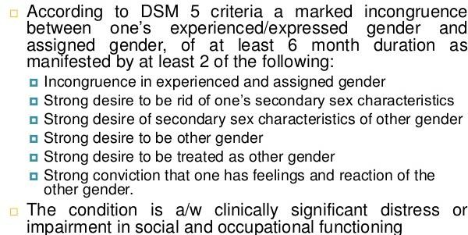
GENDER DYSPHORIA

Slide 15

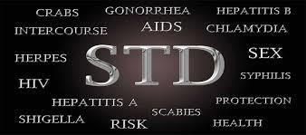
Sexually transmitted infections
Worldwide the highest reported rates of STDs
are found among young people aged 15-19 and 20-24.

Slide 16

Sleep Disturbance
During the period of rapid growth, adolescents have increased sleep requirement.
But they are deprived of sleep due to increased academic activity, parents working in shift or watching TV late into the night.
Inadequate sleep may cause poor school performance, daytime drowsiness, aggressive behavior, conduct disorder, anxiety, restless leg syndrome and depression.
Sleep deprive teens may have periods of subconscious bouts of sleep during the day time making them prone ot injuries and accidents.

Slide 17
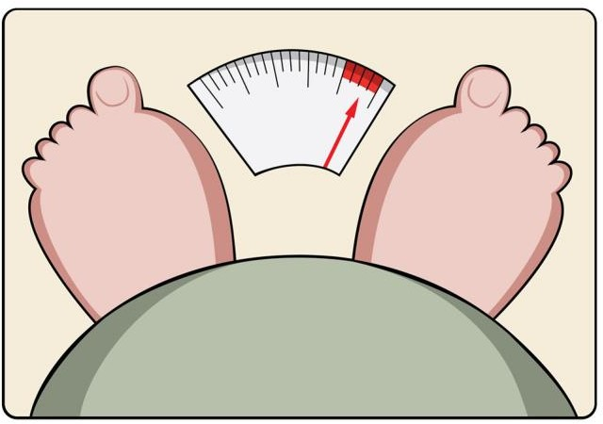

Obesity
Among Delhi school children, 5% obesity and 17-19% overweight has been reported. Similar figures are available from other parts of the urban India as well.
Prevalence of obesity and overweight is higher in boys than in girls.
Obesity has strong association with asthma, sleep disorder, reflux disease, Blount disease, slipped femoral epiphysis, gall stones, fatty liver, and numerous metabolic derangement like type 2 diabetes dyslipidemia, hypertension and polycystic ovarian diseases.
Change in sedentary lifestyle, decrease consumption of calorie dense food and increase outdoor acidity contribute to these disorders

Slide 18
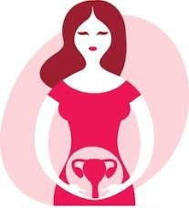
Gynecological Problems
It is common to have anovulatory and irregular menstrual cycles during first two years after menarche.
In polycystic ovarian syndrome, with a combination of menstrual irregularities and ovarian cyst with androgen excess like acne or hirsutism, occurs in around 9% of Indian adolescent girls.
The condition has association with other metabolic derangement like obesity, insulin resistance an type 2 diabetes.

Slide 19

Violence
WHO defines violence as
“The intentional use of physical force or power, threatened or actual, against oneself, another person or against a group or community that either results in or has a high likelihood of resulting in injury, death psychologic harm, maldevelopment or deprivation”.
Physical and sexual violence are common in India.
20-30% of young females suffering from domestic violence an 5-9% young females reporting sexual violence (NFHS3)
Motor vehicle and industrial accidents are common in boys whereas burns are common in girls.

Slide 20

Lack of Sex Education
The majority of Indian adolescent do not get formal sex education in an effective way,
Peers, books, internet and magazines are their main source of information about sex.
Parents and teachers often fail to discuss issues like safe sex, dating , abortion, HIV, and sexually transmitted diseases.

Slide 21


Social Challenge
MEDIA
With the availability of electronic media, adolescent are exposed to information form all across the world.
This exposure is unsupervised because of working parents an increasing use of electronic gadgets.
Due to inability to separate factor form fantasy adolescences succumb to the glamorous portrayal of tobacco or alcohol consumption, unrealistic expectations, physical aggression, destruction behavior and unprotected sex.

Slide 22


Social Challenges
PEER PRESSURE
Peer formation is a part of adolescent social development.
Pressure for conforming to norms drive many of their actions and decisions, including risk taking behavior and initiation of substance abuse.
POVERTY
Children belonging to poorer families are likely to have inadequate diets, have higher chances of having depression, antisocial behavior and engaging in drugs or sexual activity at earlier ages.

Slide 23
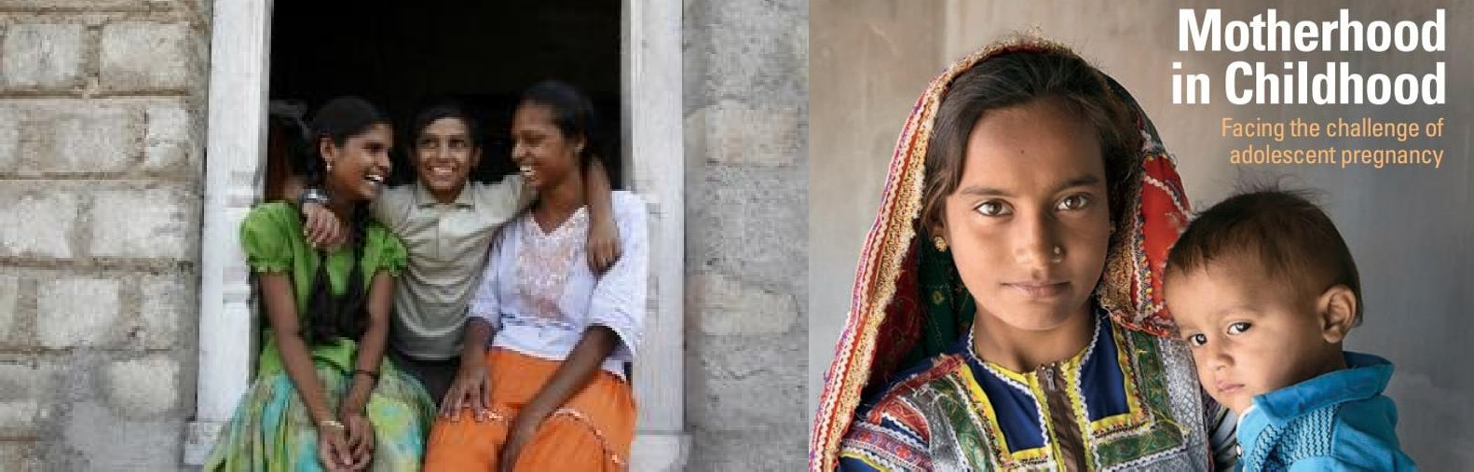
Social Challenge
ILLITERACEY
Though situation is imp[roving over the years, still 33% of Indian youth are not able to complete their primary education.
Female gender belonging to rural and poor background are risk factor for illiteracy.
Boys choose to work in young ages in the rural communiites EARLY MARRIAGE
Though the legal age for marriage is 18yr for girls, many states still have the practice of childhood and early marriage.

Slide 24

Social Challenge
ACADEMIC AND EMOTIONAL STRESS
Examination cause significant physiological and psychological stress.
Apart form rapid changes in their body structures, various other factor like peer acceptance, discrimination, academic burden, parental expectations, changing social environments cause stress among adolescents.
Some adolescents may face adjustment problems resulting in various
psychological and somatic effects.
DISCRIMINATION
Adolescent girls are often asked to limit their outdoor or extracurricular activities and are not involved in any decision making. They are expected to do household work.
Gender based discrimination is seen in education and even food distribution

Slide 25

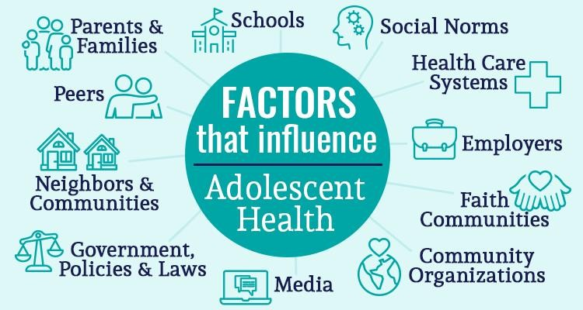
Role of Care takers
Health care providers
Educational Institutions
Families
Work place
Community
Society

Slide 26
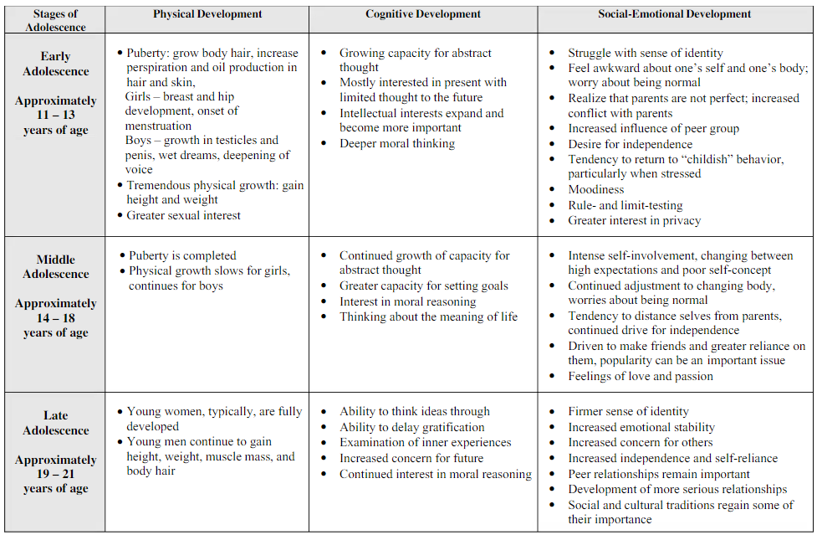
STAGES OF ADOLESCENCE

Slide 27
Reference Video Link:
https://www.euro.who.int/en/health-topics/Life- stages/child-and-adolescent-health

Slide 28

Thank you

